Slide 1
Artificial Intelligence (AI)

Slide 2
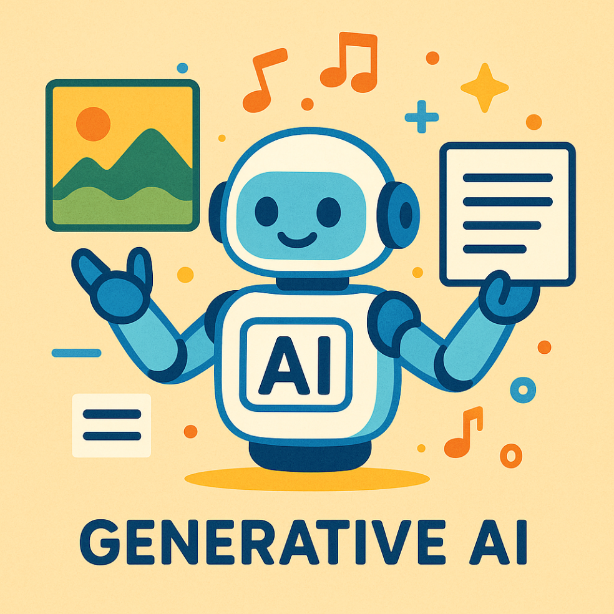
What is Generative AI?
A type of computer program that creates content [based on patterns that it has learned]
Text, images, videos, audio
Examples:
Answer questions, rewriting text (more formal, friendly), summarising text, translating text, designing greeting cards, writing stories, creating itineraries, fixing pictures, recommender systems etc.
Think of it as a smart assistant that “learns” from many examples, and then mixes that knowledge to produce something new

Slide 3
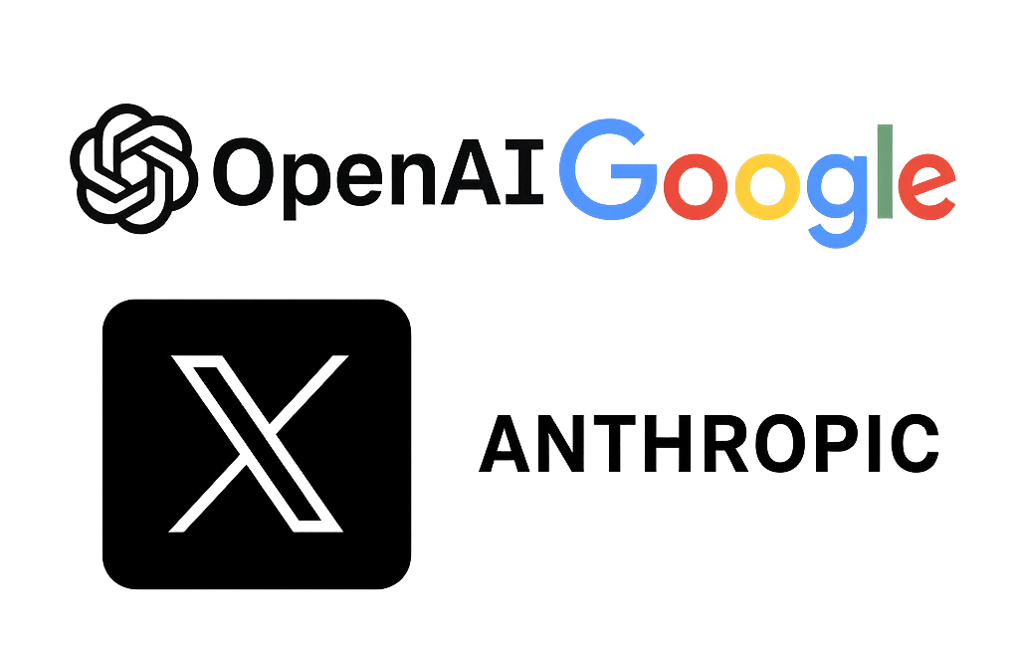
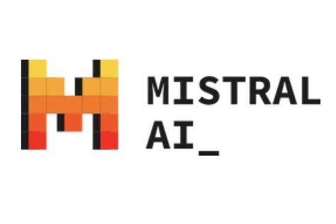

Generative AI providers
OpenAI (ChatGPT)
Google (Gemini)
Anthropic (Claude)
Mistral (Le Chat)
Meta (Meta AI)
Grok (X/Twitter)
Open Source / Self-Hosted:
Meta (Llama)
Deepseek
Alibaba (Qwen)
Mistral (Pixtral)

Slide 4
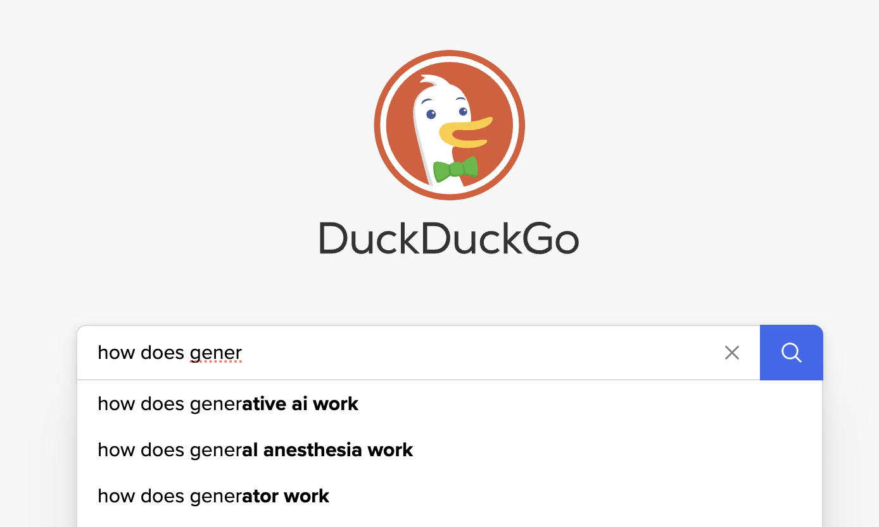
How does it work?

Slide 5
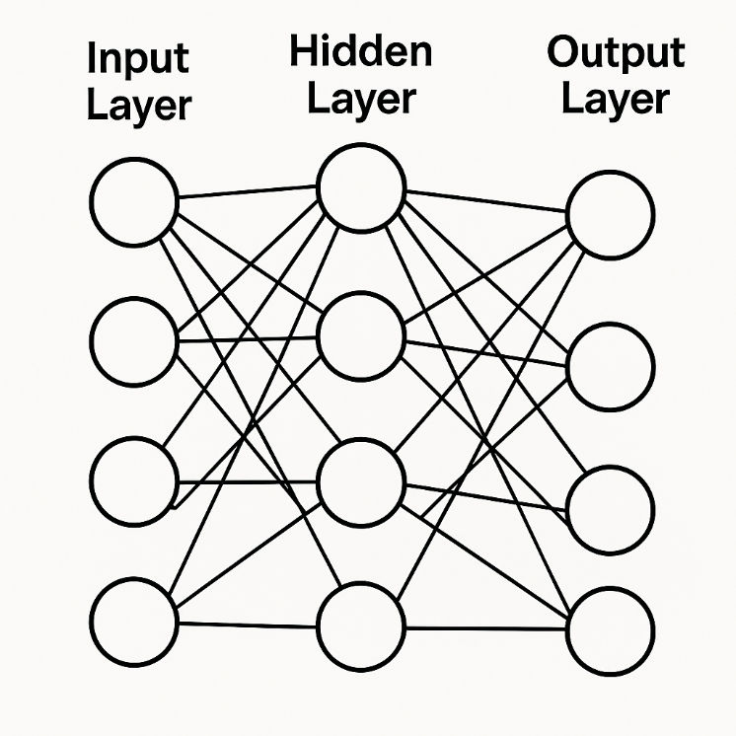
How does it actually work?
The AI learn from lots of data (like reading many books) and then use patterns they learned to “guess” what should come next in a sentence
Imagine learning a dance by watching billions of dance performances… then using those moves to create your own routine
Training:
Internet content (websites, social media)
Scientific books
Humans help with the training by providing feedback
Common for grounding to happen with internet access (search)
Notes:
A neural network is like a mini-brain made of tiny units called neurons that work together. It has layers: the input layer takes in information (like pictures), hidden layers help it learn patterns, and the output layer gives the final answer (like saying whether a picture is a cat or a dog). Each connection between neurons has a weight that helps the network improve its guesses based on practice with lots of examples. By adjusting these weights through training, the network gets better at making predictions over time.
In generative AI, neural networks are used to create new content. For example, a neural network can learn from thousands of cat and dog images to generate entirely new images that look like real cats and dogs. Similarly, in text generation, models like ChatGPT use neural networks to understand how to write sentences and can create stories or answer questions based on what they've learned. This ability to generate new and realistic content is what makes generative AI so exciting!

Slide 6
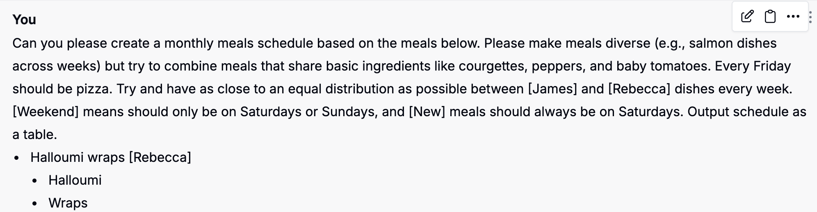
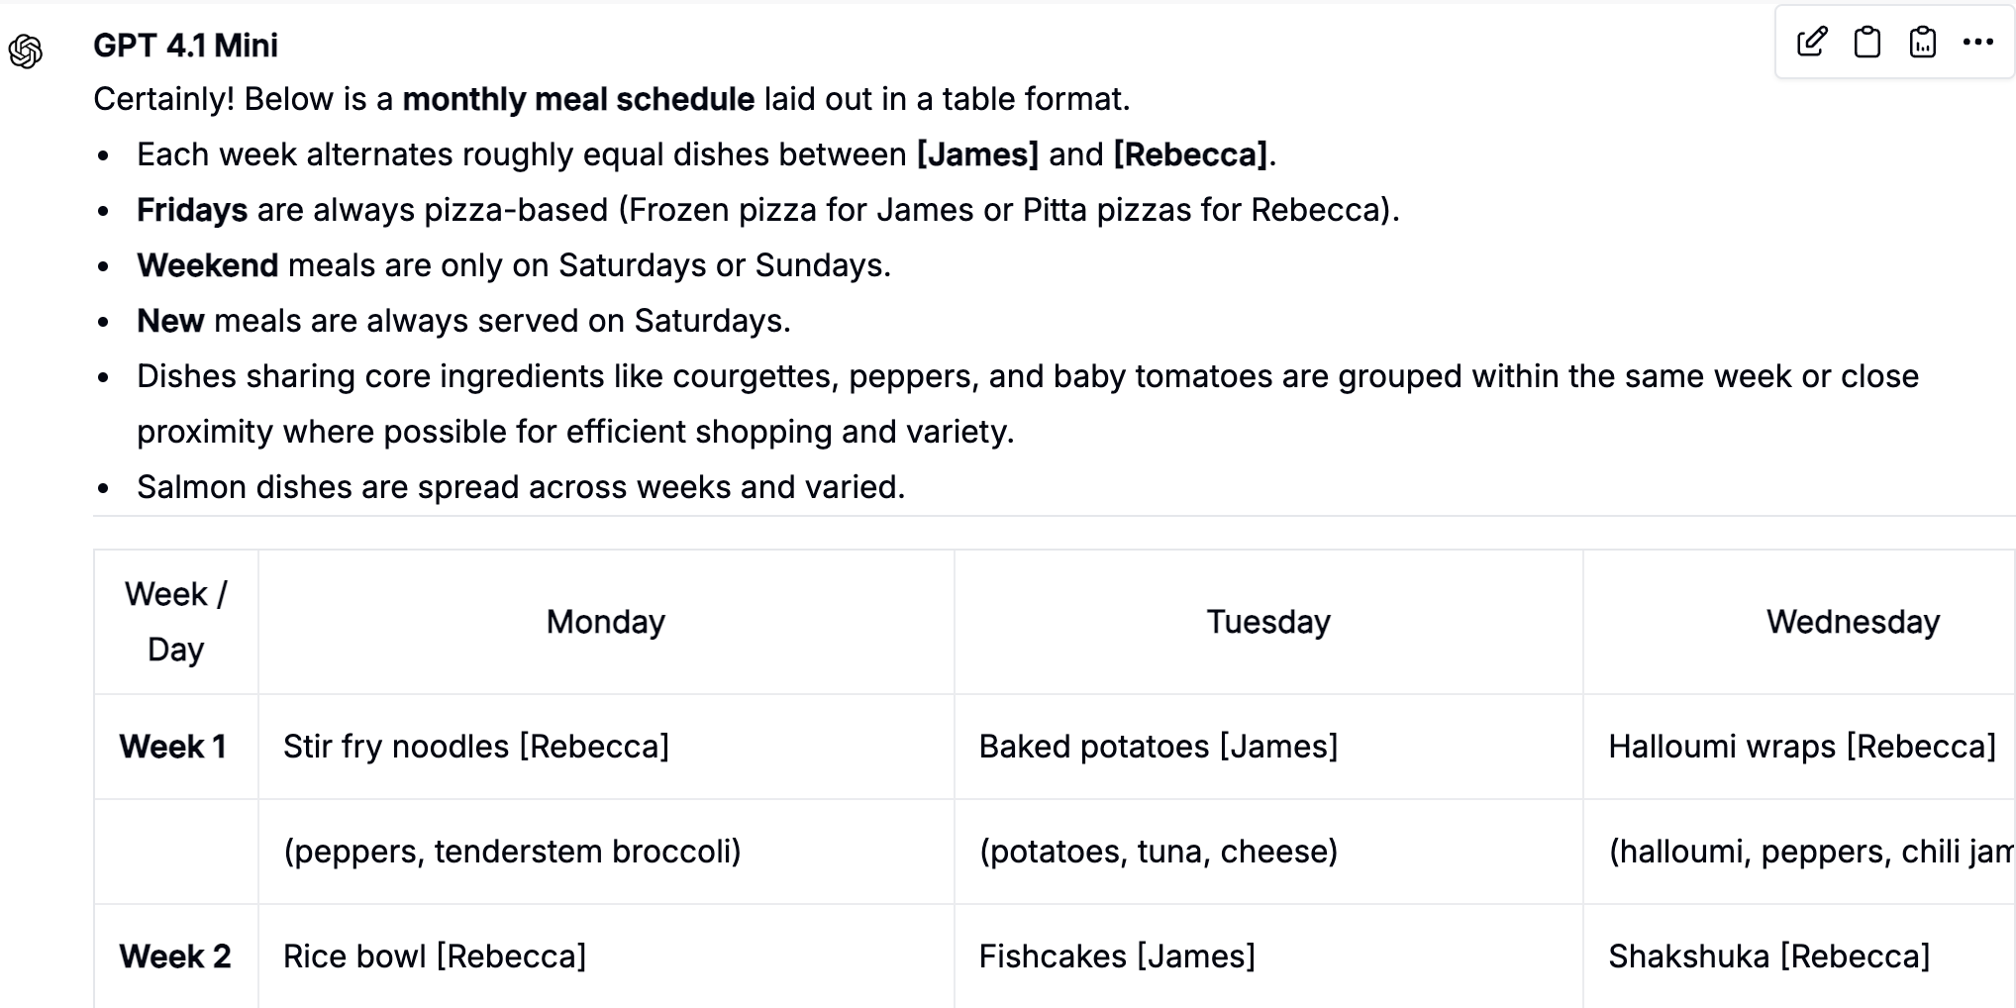
Pros of Text Generation
Easy access to information
Help with day-to-day tasks
Brainstorming, writing, summarising, planning, fixing toilet
Entertainment

Slide 7
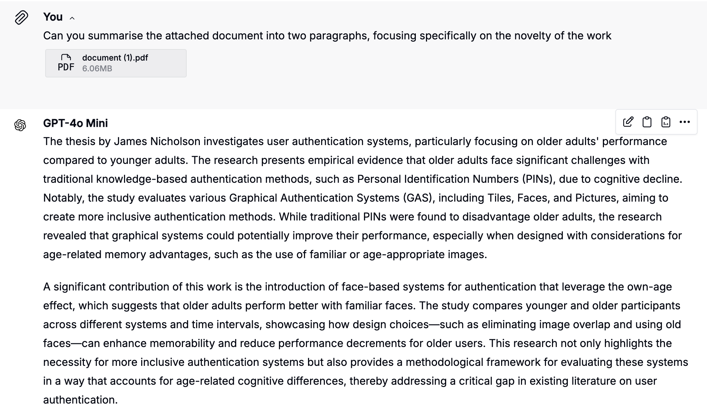
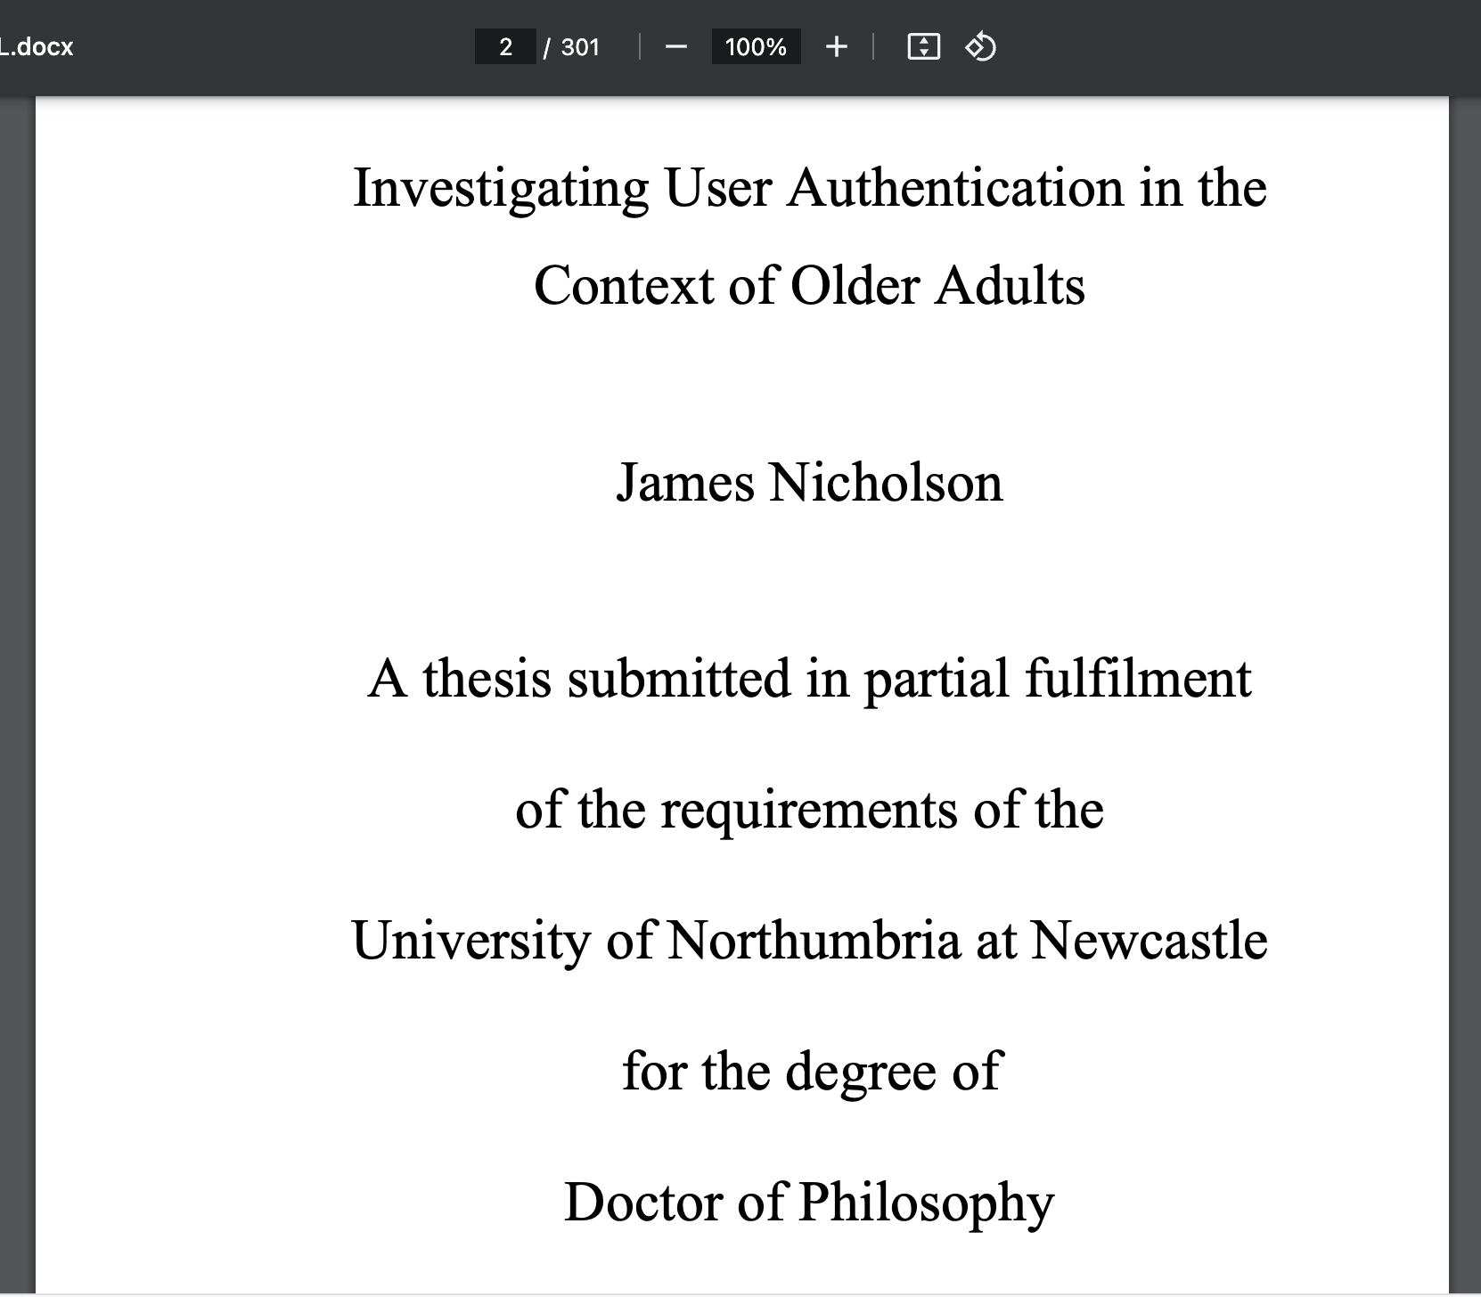

Slide 8
Cons of Text Generation
IP theft
Environmental costs
Loss of critical thinking
Job losses
Hallucinations
“yes man” responses
Mental health failures

Slide 9
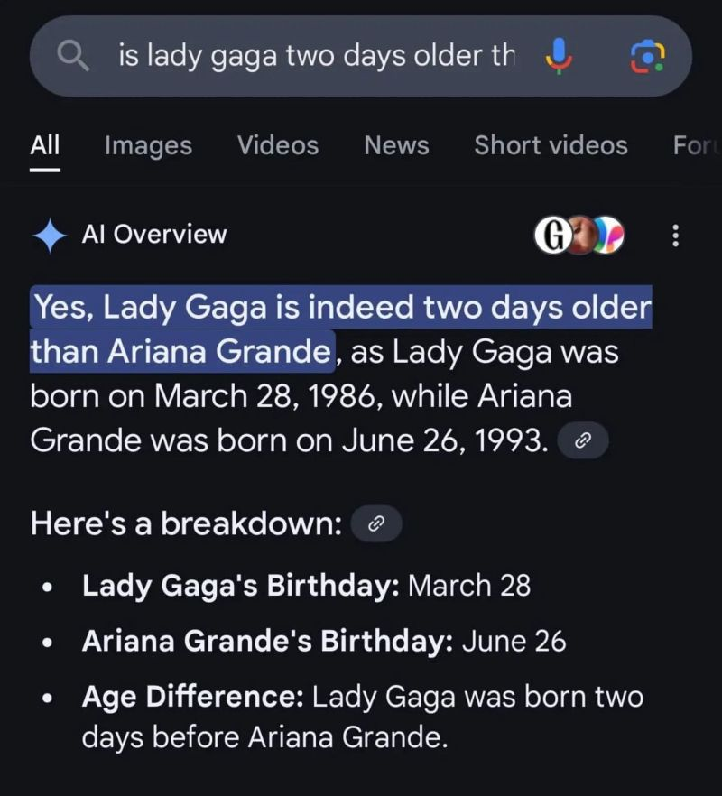
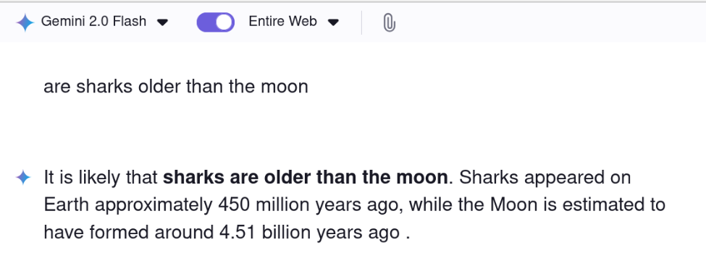
Cons of Text Generation
IP theft
Environmental costs
Loss of critical thinking
Job losses
Hallucinations
“yes man” responses

Slide 10
Security risks of text-based AI
Can help scammers scale attacks (easier to carry out)
Phishing
Romance scams
Website generation / technical tasks
But also:
Can provide information and help (as models become more accurate)
Can help identify phishing messages
Can bait scammers (and bots)

Slide 11
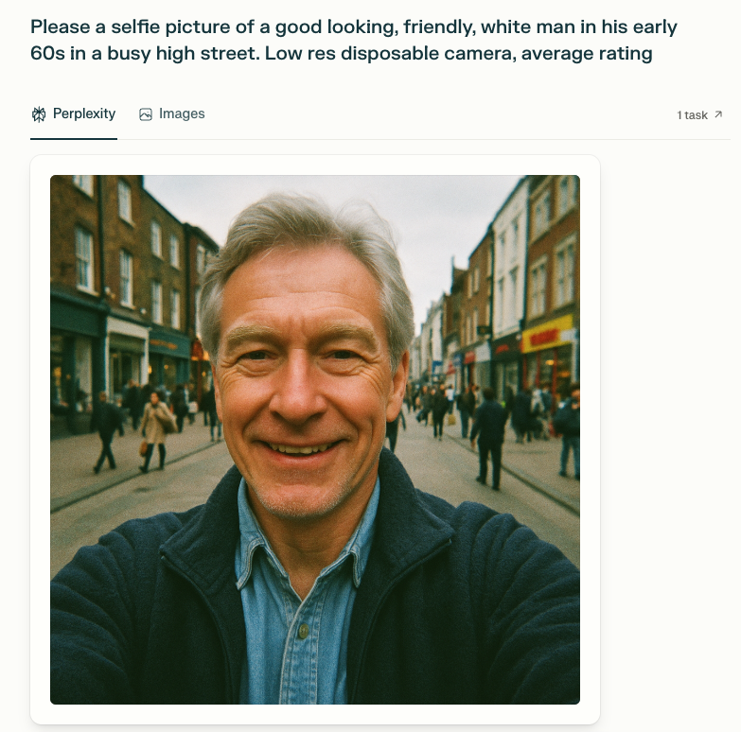

Slide 12
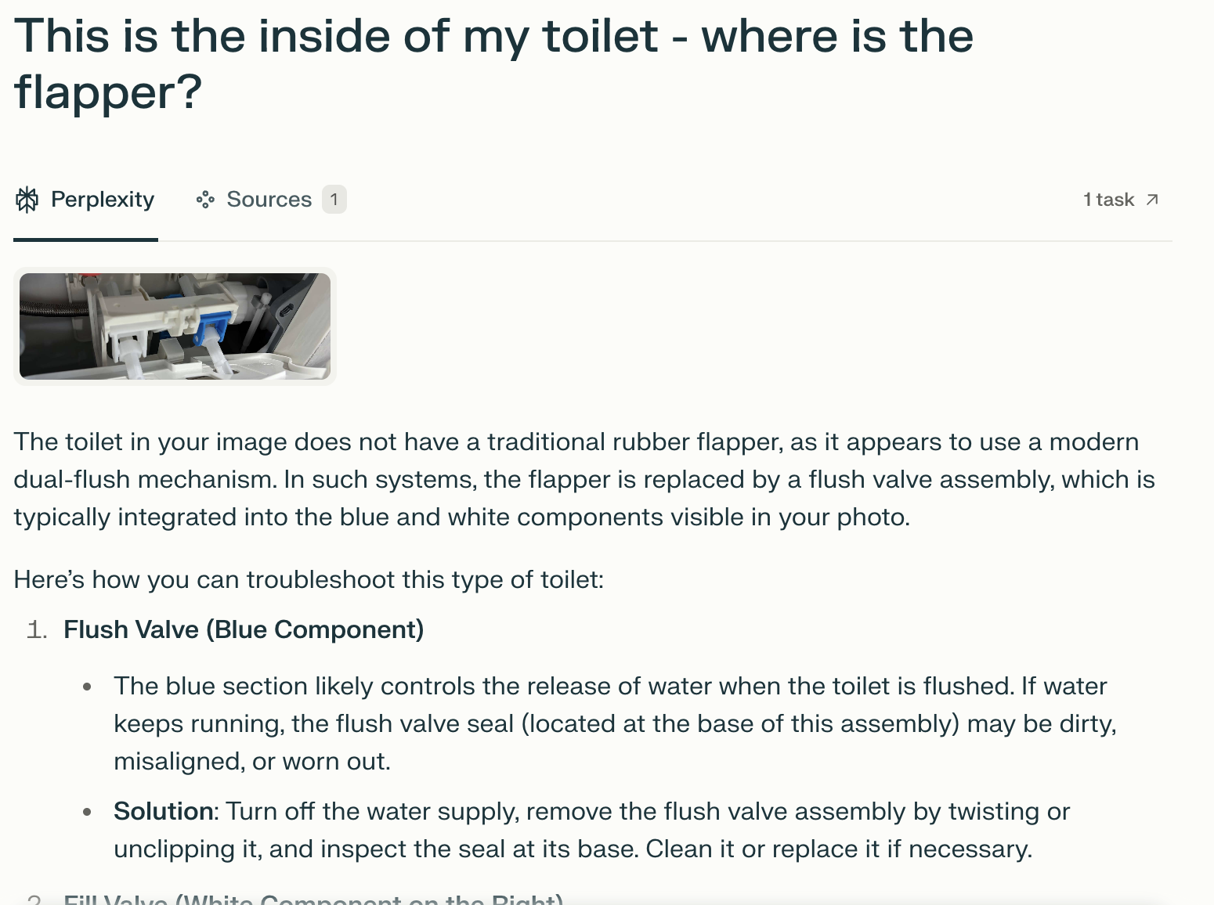

Slide 13

Pros of Multimedia Generation
Easy access to generating art
Help with design process (e.g., prototyping)
Can fix photos
Entertainment

Slide 14

Cons of Multimedia Generation
IP theft
Proliferation of rubbish content
Environmental costs
Destroys artist jobs
What is real???

Slide 15

Is this picture real?
Look out for weird fingers.
Some window weirdness.
Also, paintbrush is backwards (inconclusive by itself).
Same with the palette – doesn't match the artwork, but not conclusive.

Slide 16

Is this picture real?
No… but very hard (impossible?) to tell…

Slide 17
Image Gallery
If you know the words, you can create the visuals
https://www.midjourney.com/explore?tab=top_month

Slide 18
Videos can also be generated using AI
https://www.which.co.uk/news/article/quiz-could-you-spot-a-deepfake-a5Bk99o6oaPW

Slide 19
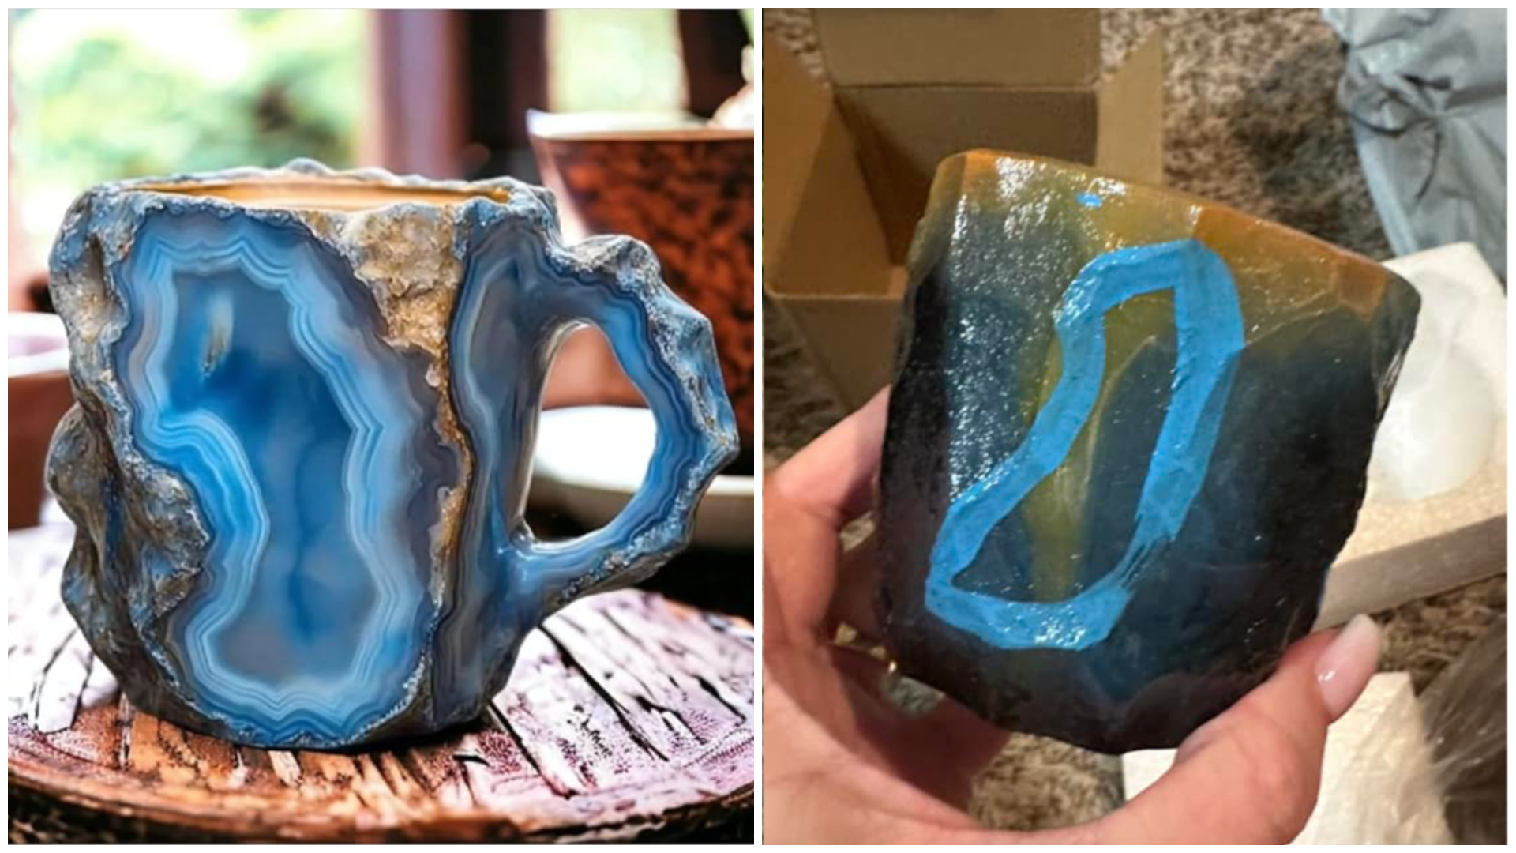
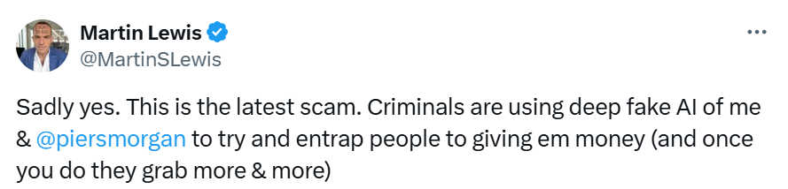
Security risks of Multimodal AI
Can help scammers be more convincing
Romance scams (pictures/videos)
Fake products (pictures)
Voice cloning for phone calls
Celebrity endorsements
But also:
Can provide information and help (as models become more accurate)
Can help identify phishing messages
Can bait scammers (and bots)

Slide 20
Privacy Risks of Generative AI
Training: Many AI systems will log user interactions to improve the models (”training”).
Any personal or sensitive information could be stored and accessed by third parties, or used to generate content for other people
Prompt Injections: It is possible to reveal sensitive data that has been learned by the AI if you craft queries carefully (hack it)
Breaches: It may be possible for personal/sensitive data that has been inputted to be identified if the Generative AI provider suffers a data breach

Slide 21
Key Takeaways
Generative AI has become much more powerful in the last few years
It is very useful for all kinds of things, but has personal, environmental and societal costs that are still emerging
It is a good idea to try using it, at least so that you can recognise it and be aware of current capabilities
Remember that images and videos on the internet are now very easily faked
But
Beware of “hallucinations” (made up information)
Don’t become dependent
Remember the environmental cost

