Slide 1
Authentication

Slide 2
Passwords
Passwords are widely used to authenticate users
  Authenticate = Check that you are who you say you are
Websites should never need to actually have your password, they use hashing instead
Hashing uses maths to turn the password into code in a way that can’t be reversed

Slide 3

Hashing is a one-way function
Hash Function
(SHA-256)
7c914ae5b2604eab8c550193ffbeb5ddc1582afeaee9eefdb2f046f8652bb9d8
”I can read this”

Slide 4
What happens to the juice?
The same password will produce the same hash (juice) every time
Legitimate websites just store the hash (juice)
When you type in your password to log in, your computer juices it and only sends the juice to be checked
If it matches what they have on file, you are who you say you are
If stored passwords are exposed in a data breach, they are usually juice
Many lists of juiced passwords are available for sale

Slide 5
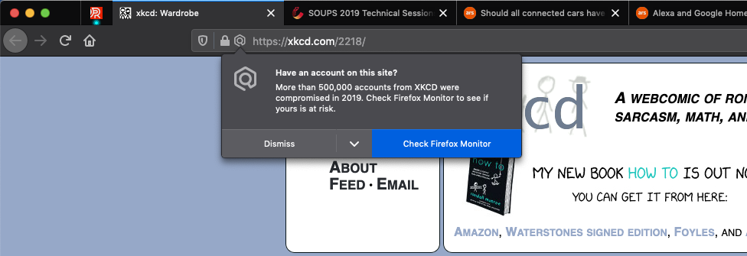
The importance of unique passwords
https://haveibeenpwned.com/

Slide 6
How do hackers turn juice back into passwords?
This is called password cracking
Because the hackers have a list of hashes, they aren’t restricted to a few guesses (like they would be when using a website, or when trying to get into a phone)
Their process:
  Pick a password to try
  Juice the password
  Check the list. Has anyone used this password?
  Repeat
Sound slow? They can check thousands, millions, or even billions per second!

Slide 7
Password cracking option 1: brute force
Simply try every possible password, starting with the shortest
If you use a password that is short and simple, they will find it

Slide 8
First hurdle: Get past brute force
Passwords that are longer and use different types of characters (upper case, numbers, symbols) get exponentially harder to crack this way
Therefore, passwords should be strong
But, that’s not all!

Slide 9
Password cracking option 2: dictionary
Having a strong password is no help if it is predictable
Before trying all possible passwords, they’ll try a list of likely possibilities, including:
  Every word in the dictionary (doesn’t matter how long)
  Every password that has previously been exposed in a breach
  Common patterns of these with added numbers/symbol replacements
Therefore your password should be unique
It should not be used anywhere else

Slide 10
Second hurdle: be unpredictable
Password strength checker
https://bitwarden.com/password-strength/
Exposed passwords checker
https://haveibeenpwned.com/Passwords

Slide 11
Tips for creating good long passwords
Three or more random words
  Truly random and unrelated to each other
  Ideally: Include upper case, lower case, a number and a symbol
  E.g. potato-9feline-Vacuum
Passphrases
  “I have a hard time remembering passwords for online account” => Ihahtrp4ola
  “Northumbria University teaches me about security every week” => NUtmas3w
Non-personal!
People may still try to guess your password manually if they’re targeting you directly. Don’t use
  Names of people close to you
  Dates, addresses, phone numbers
  Anything people might find out about you

Slide 12
You might need to compromise
Key accounts should be unique (bank, email, iCloud)
You can have account tiers: low/medium/high importance
You could use a “Password for Life”
  A main strong password that you tailor to different accounts
Unique passwords can be written down, but securely

Slide 13
Another approach: Password Managers
Password managers are services that store your passwords for you.
You need to remember one very strong master password
Stored passwords are encrypted using the master password
  Encryption is like hashing (juicing) but it can go both ways
Without the master password, nobody can access the passwords, even if the service is breached
Password managers can:
  generate excellent passwords for you
  warn you if your passwords are unsafe
  automatically remember new passwords
  type them in for you

Slide 14
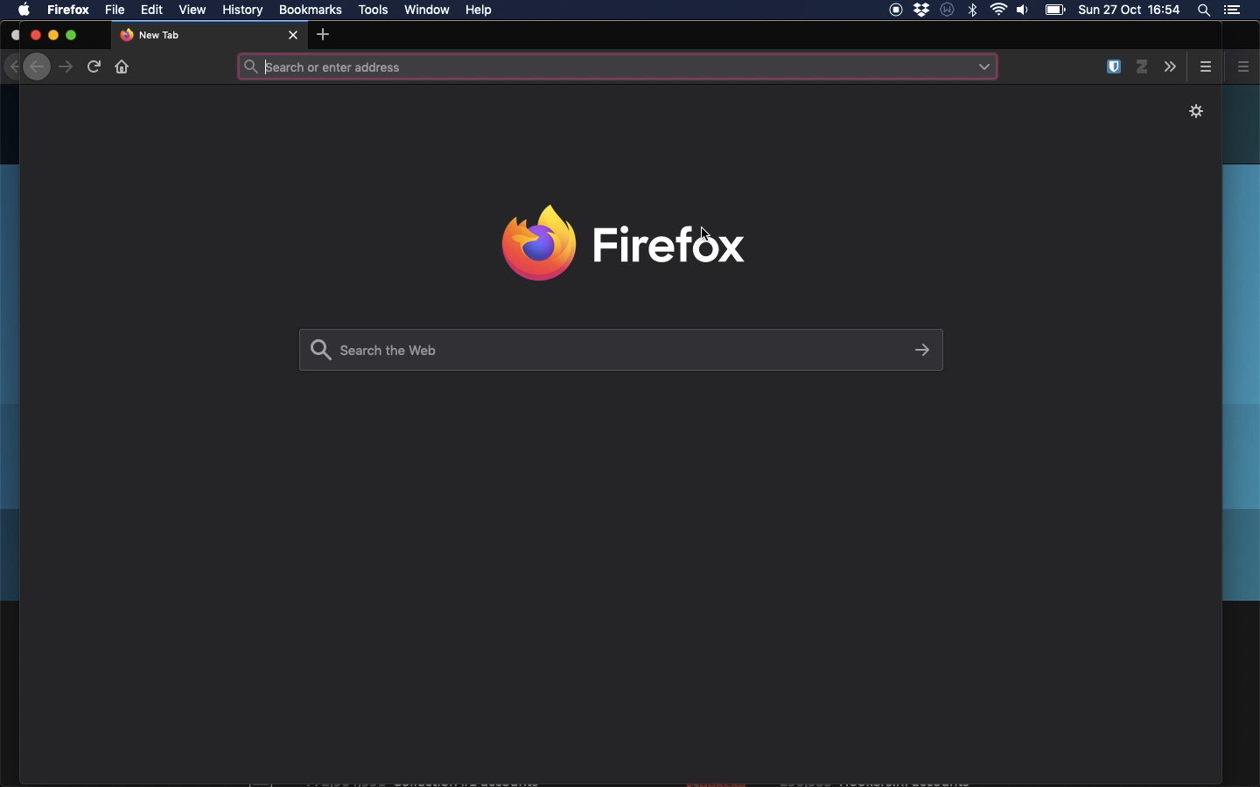
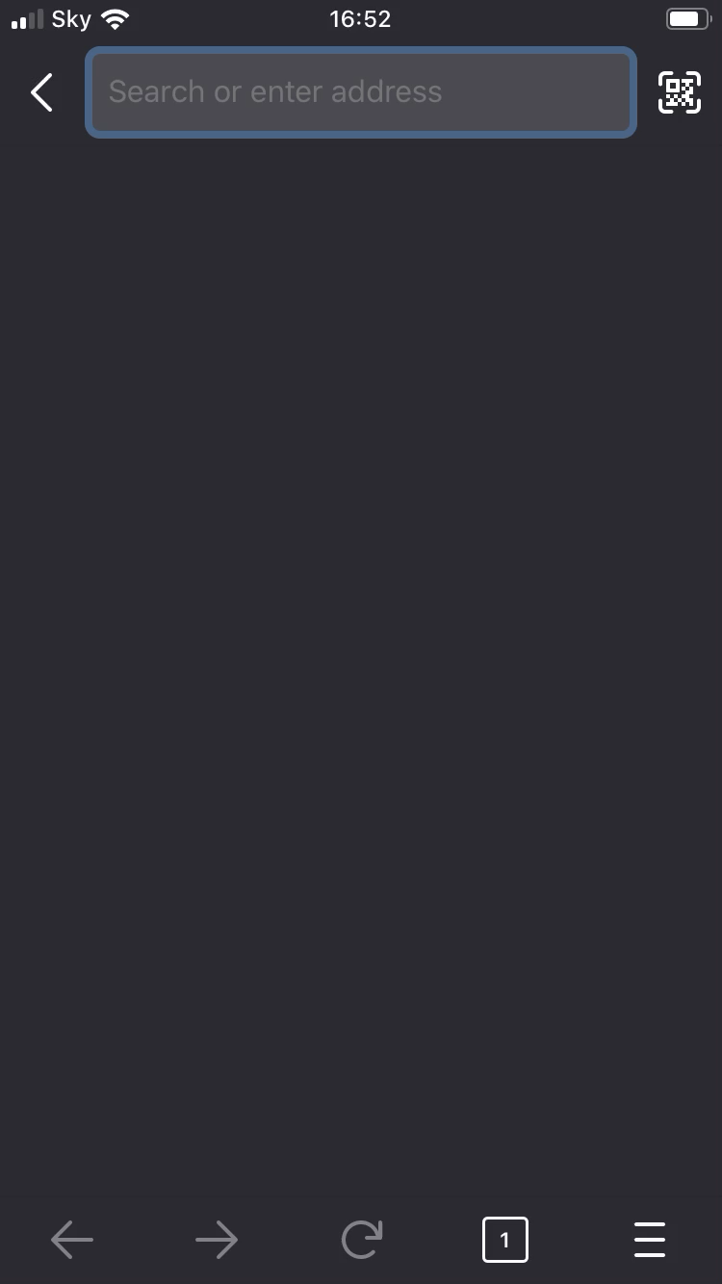

Slide 15
Choosing a password manager
Built in (Apple, Google, Samsung)
  + Convenient, free
  - Ties you into your ecosystem
Browser based (e.g. Google Chrome, Firefox)
  + Convenient, free
  - May lack functionality, ties you into your browser
Standalone (e.g. Bitwarden, Lastpass, many more)
  + Versatile, use across different systems
  - Can cost money, or have a restrictive free tier

Slide 16
Two Factor Authentication (2FA)

Slide 17
Using multiple factors
Passwords prove who you are by providing something only you know. This is a factor.
Other main types of factor
  Something that you have (e.g. your mobile phone)
  Something that you are (e.g. your fingerprint)
Two-factor authentication (2FA) introduces a second factor in case someone learns your password.
With 2FA, someone who is not near you in the real world usually won’t be able to access your account, even with the password.

Slide 18
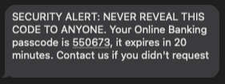
SMS Text Codes
It is common to use codes sent by text message. Typing the code proves that you have your mobile phone.
Convenient, as only need to give out number and code will be sent out when required.
Make sure that if you use this option you can rely on good mobile signal.
Not foolproof – determined hackers can sometimes hijack sim cards so that they receive the message instead

Slide 19
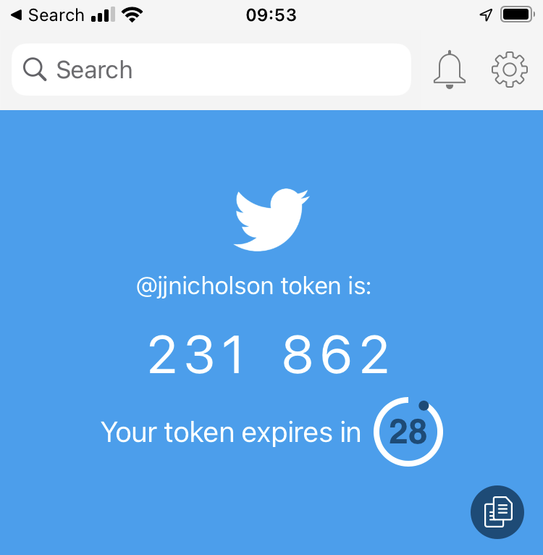
Authenticator Apps
Google Authenticator
Microsoft Authenticator
Duo Mobile
Authy

Slide 20
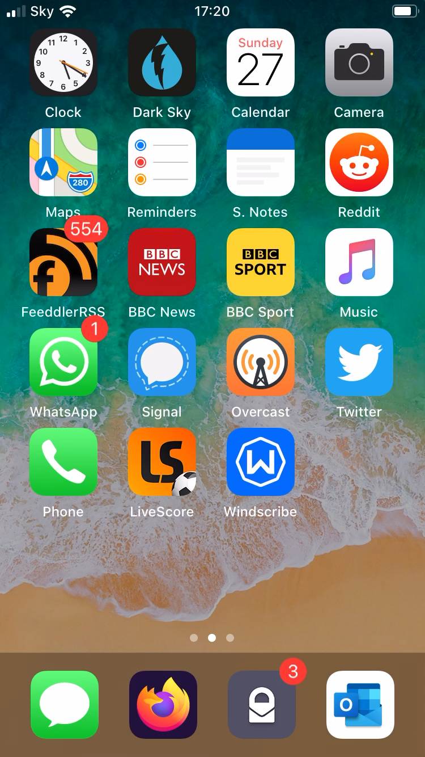
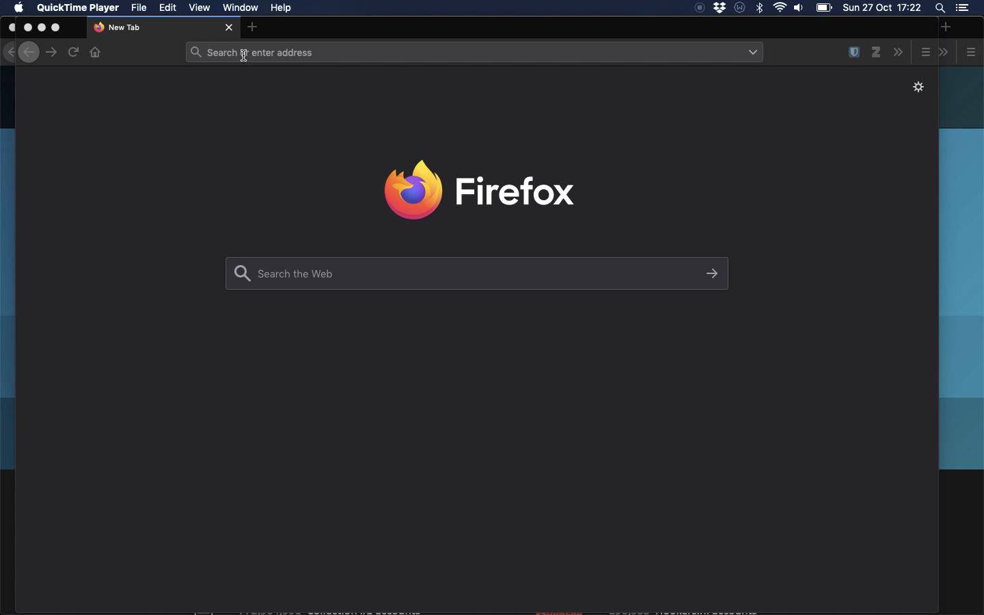

Slide 21
Drawbacks
Slower
  But only need to enter code during first login on each device (or at least irregularly)
  On unknown devices, yes, ask…
Need extra device (usually a mobile phone)
Can get locked out: e.g. if you change phone

Slide 22
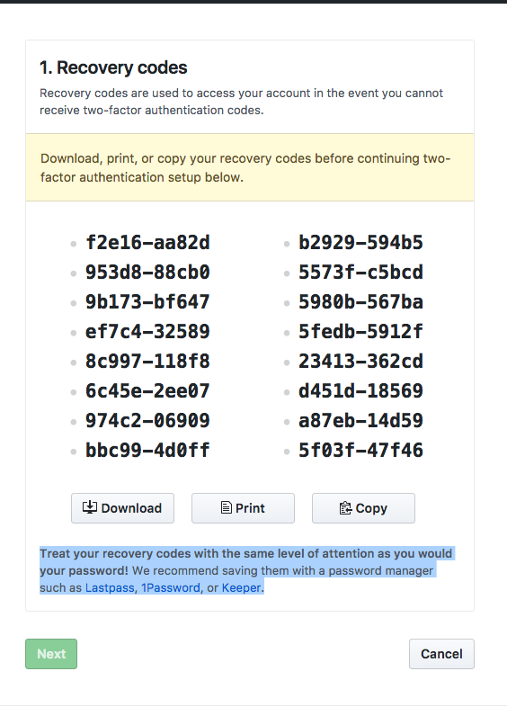
Back Up Codes
These are important!
They will bypass 2FA
  If you lose your phone
  If you change your phone
  If you need someone to access your account
Save carefully:
  An attacker can use these to bypass 2FA

Slide 23
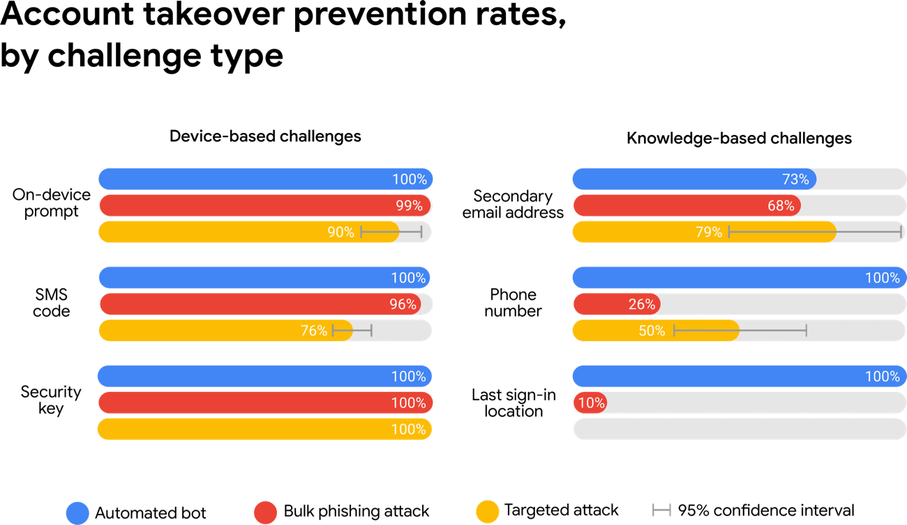
Why should I use it?

Slide 24
Tips
Enable for most important accounts (e.g. email, Amazon), but doesn’t hurt to do it for other accounts too
What services support 2FA?: https://2fa.directory/gb/
Save Back Up Codes
  Obtained when enabling 2FA

Slide 25
Password Alternatives
One-Time Passwords / Magic Links
Sometimes, instead of using passwords, websites will email or text a code or link to you when you want to log in
The logic
  Your email account should be well secured already
  In most cases, the email is how you reset a password anyway
  Only used once and will expire, so a compromised code is less risk than a compromised password
  No need to remember anything
But
  Password AND Code (i.e. 2FA) is still much stronger
  Remember to never share one-time codes with anyone

Slide 26
Password Alternatives
Single Sign-On (SSO)
Sometimes, websites or services will offer you to “Sign in with …”
  Google, Facebook, Apple etc
  A place of work
Benefits
  Quick
  No new passwords
  As secure as your existing login (e.g. maybe you have 2FA set up)
Downsides
  That company gets data about where you sign in
  If your login for that company is compromised, this new account is too
  Makes you dependent on them
  Phishing risk

Slide 27
Password Alternatives
Passkeys
Up and coming, not yet widely used (but growing)
Your device creates a pair of virtual keys
  One on the service you’ll use them to access
  One on your device or password manager (passkey)
These two keys allow the service to ask your device a question that could only be answered if it has the passkey
The passkey is kept on your device or password manager
Your device or password manager will only give the answer if you tell it to (e.g. using your fingerprint to check who you are)
Passkeys are very secure, just not very common yet

Slide 28
Authentication summary
Passwords should be strong so that they can’t be cracked if they are leaked
  Three (truly) random words is an easy way to make strong passwords
  Don’t be predictable
Passwords should be unique so that one data breach or accidentally shared password does not affect other accounts
  Ideally, every account has a different password
  Password managers can make this easy
Use Two-Factor Authentication (2FA) on important accounts
  SMS is better than nothing, but authenticator apps are best
  Save your backup codes if you use an app
Be open to using passkeys when they become more common

