Slide 1
SPOTTING TRUSTWORTHY INFORMATION A Practical Guide for Navigating Today's Media

Slide 2
Welcome!
Today’s goals:
Identify trustworthy UK news sources
Learn practical fact-checking techniques
Protect yourself from scams
Build confidence in spotting misinformation

Slide 3
What Are We Talking About?
Misinformation: False information shared without intent to harm (mistakes, misunderstandings)
Disinformation: False information deliberately created to deceive or manipulate
Fake News: Fabricated stories designed to look like real news articles
Notes:
Misinformation is incorrect content shared unintentionally. Often shared on social media, Misinformation can be inaccurate for a range of reasons. What sets it apart from other types of false information is the unintentional nature of its dissemination; additionally, while other types of false information are created for a particular purpose, Misinformation is not.
Disinformation is incorrect content that is created/shared intentionally to mislead and change minds. Disinformation is often related to politics and is intended to influence the general public. It is often presented as the truth and characterised by being false due to information being altered/omitting key facts.
Disinformation differs from Misinformation in its intentionality: Disinformation is intentionally shared with the goal of misleading or changing minds.
Fake News is news-style content shared intentionally for consumption by the general public and specific groups. It is often about politics, war, and health. Created deliberately, Fake News can be created to cause harm and/or mislead. Fake News is often intentionally shared to change minds, promote or demote someone/something, or for the benefit of the sharer/another party.
Fake News is the false information type with the most overlap with the other false information types presented in this paper. Fake News is associated with news-style content, a specific visual cue. It has some key differences with Disinformation: Fake News often includes edited sources and an intention to cause harm/promote/demote others, whereas these characteristics are not associated with Disinformation.

Slide 4
The Impact of Misinformation
Misinformation affects:
Your health decisions
Your finances and savings
Your vote and civic participation
Your relationships with family and friends
Your trust in institutions
Notes:
Then explain how in turn each of these things effects your susceptibility to misinfo and the fact it’s a vicious cycle.

Slide 5
Everyone is Vulnerable
90% of UK adults have encountered false information online, with 4 in 10 UK adults encountering misinformation in a single month according to Ofcom!
Sadly, older adults are specifically targeted by scammers
Even experts can be fooled
But, good news! Skills can be learned

Slide 6
Understanding Trustworthy (UK) Sources
What makes a source reliable?

Slide 7
Trusted UK News Organisations
Broadcasters:
BBC
ITV News
Channel 4 News
Sky News
Major National Newspapers:
The Times / The Sunday Times
The Guardian / The Observer
The Telegraph
Financial Times
The Independent

Slide 8
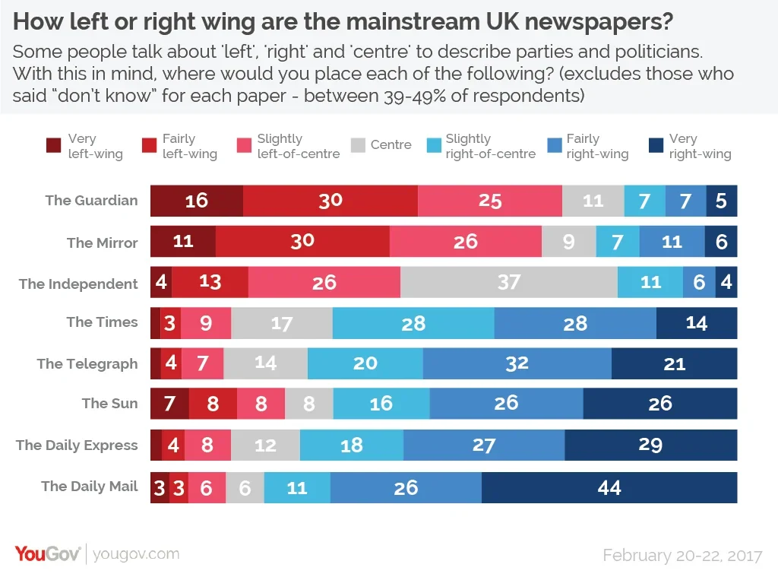
Important Distinction
Bias: A particular perspective or political leaning
Newspapers that have bias aren’t automatically misinformation – can still be factually accurate (Altay, 2023)
Some present more politically aligned content
Image credit: YouGov

Slide 9

Important Distinction
Unreliability: Consistently publishing false or misleading information
Not the same as bias
Image Credit: Newsround

Slide 10
So, Who Keeps an Eye on the News?
ISPO (Independent Press Standards Organisation)
Regulates newspapers and magazines (print media)
Handles complaints about accuracy
Ofcom
Regulates TV and radio broadcasters
Ensures impartiality in news
The public can complain to ISPO or Ofcom if you spot serious issues in news content.
Notes:
… but how do we spot serious news???

Slide 11
Red Flags for Fake News Sites
Warning Signs:
✗ URL mimics real news (e.g., "bbc-news-daily.com" instead of "bbc.co.uk")
✗ Excessive spelling or grammar errors
✗ No "About Us" page or contact information
✗ Sensational headlines that don't match the story
✗ No author name or credentials
✗ Lots of pop-up ads
✗ "Share before it's taken down!" urgency

Slide 12
Fake News can also be Scams
Common UK Scam Pattern
Fake news article claims:
Martin Lewis endorses investment scheme
Deborah Meaden backs new business opportunity
Holly Willoughby promotes weight loss pills
The Truth: These celebrities are victims of fake ads
They're suing the platforms
They never endorsed these products
Always check the celebrity's official channels
Notes:
… the scheme is a scam
… the business opportunity is fake
… the weight loss pill doesn’t work or is dangerous
People believe it because of the use of the celebrity, plus the celebrities are victims too

Slide 13
Skill 1: Stop, Question, Check, Decide
When we are exposed to information, we are more likely to believe information depending on the relationship we have with them.
Family members are typically the people we trust the most, because they are the people we are inherently closest to – assuming there hasn’t been something that has reduced the closeness of the relationship we share with our family.
Then friends, co-workers, neighbours, so on.

Slide 14
Actors Trust Spheres
7
6
Facilitator
5
Friend
4
3
2
Your best friend
1
Your partner
You

Slide 15

Actors Trust Spheres
7
6
Facilitator
5
Friend
4
3
2
Your best friend
1
Your partner
You
The weather?
The Local Events?
World politics?
The best cure for a disease?

Slide 16
Actors Trust Spheres
7
6
Facilitator
5
Friend
4
3
2
Your best friend
1
Your partner
You
Sports?
Your favourite food?
Technology?
Where to live?

Slide 17
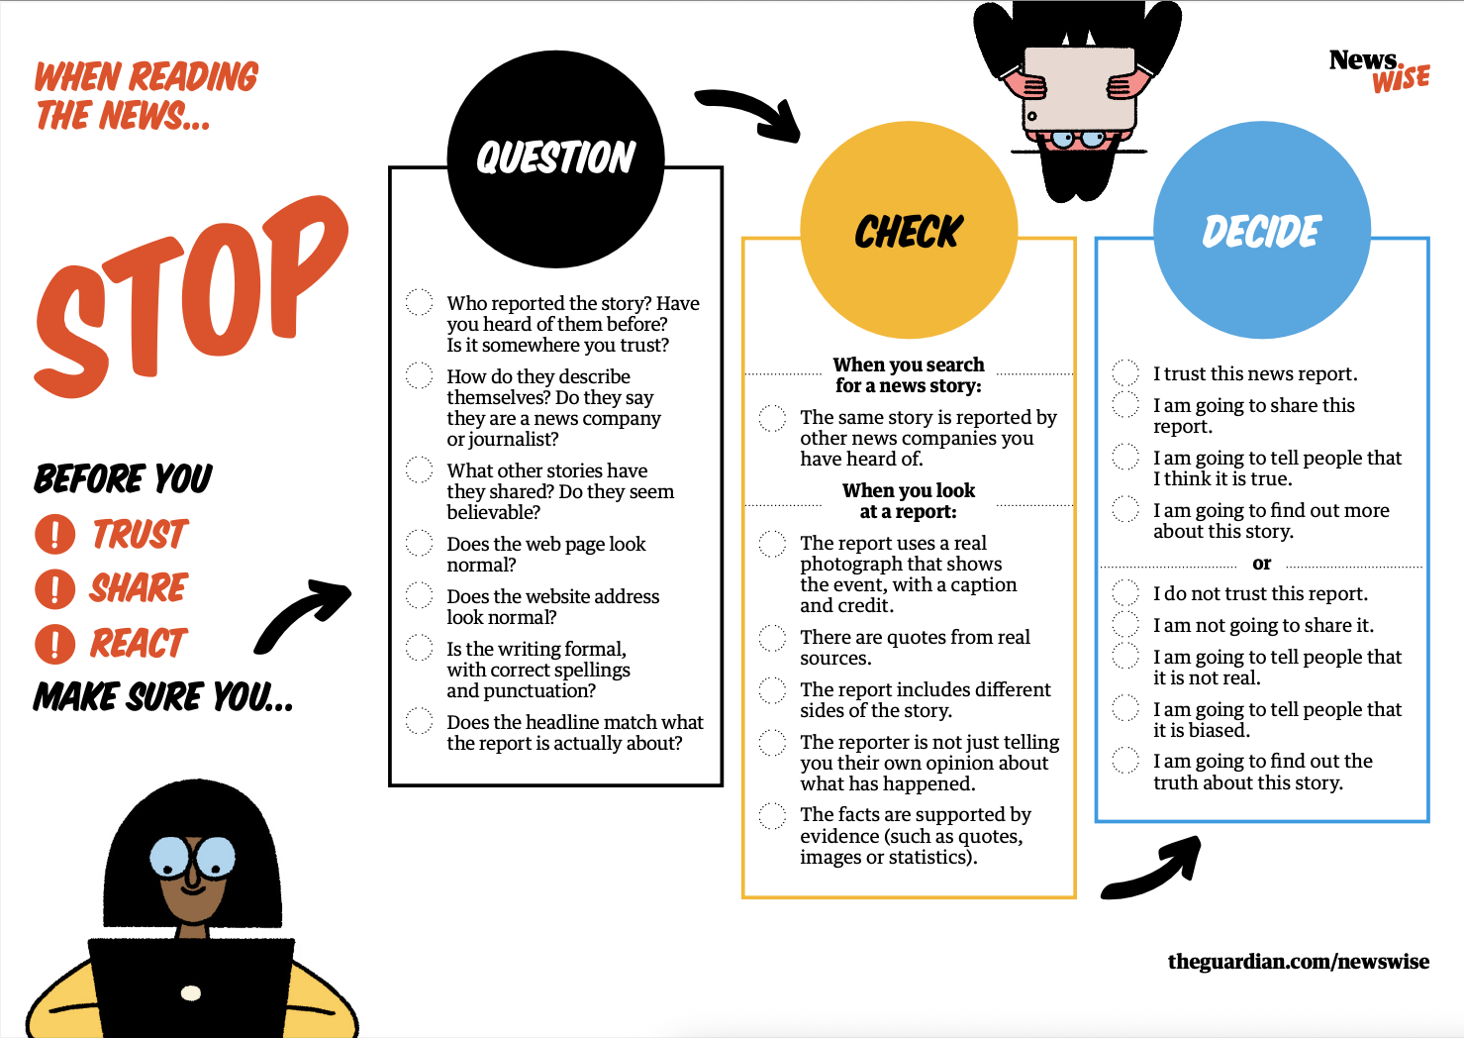

We'll look at 5 websites together and decide:
Trustworthy or not?
What are the clues?
Get out your handout and follow along!

Slide 18
BBC News Article
URL: https://www.bbc.co.uk/news/uk-politics-12345678 Headline: "Chancellor Announces New Budget Measures" About the site:
Official BBC website
Has "About the BBC" section
Author byline: "By James Landale, BBC Political Correspondent"
Published date clearly shown
Related articles from BBC News archive
Standard BBC formatting

Slide 19
Breaking News Daily
URL: www.breakingnewsdaily.com.co Headline: "SHOCKING: Royal Family Secret EXPOSED - Share Before Deleted!!!" About the site:
No "About Us" page
No contact information
No author name given
Article says "sources say" but doesn't name them
Multiple spelling errors
Lots of popup ads
Other headlines are all sensational

Slide 20
The Guardian
URL: https://www.theguardian.com/politics/2024/article-title Headline: "Government faces criticism over housing policy" About the site:
Well-known national newspaper
Clear "About Us" section
Author: "Jane Smith, Social Affairs Correspondent"
Article cites specific sources and quotes
Related coverage from other journalists
Contact details for newsroom

Slide 21
Gov-uk Pensions
URL: www.govuk-pensions.org Headline: "Claim Your Pension Refund Now" About the site:
URL looks similar to government site but ends in .org
Asks for personal information immediately
"Limited time offer"
Claims to be official government service
Poor grammar: "Your entitled to refund"
No official government logo or crown

Slide 22
Full Fact
URL: https://fullfact.org/health/vaccine-claim-debunked/ Headline: "Viral claim about vaccines is false" About the site:
Independent fact-checking organization
Registered UK charity
Clear methodology explained
Sources and evidence linked
About page with team information
Contact details provided
Checked by multiple fact-checkers

Slide 23


Skill 1: Stop, Question, Check, Decide

Slide 24
Fact-Checking Like a Pro
Don’t take anything at face value!

Slide 25
Skill 2: Lateral reading
Don't Read Down, Read Across
Instead of: Reading the article top to bottom
Do this: Open new tabs and research the source first
Steps:
See a claim or article
Open a new tab
Search for the website/author
What do others say about them?
Then decide if you should read the original
Skill 2: Lateral reading

Slide 26
Skill 3: Reverse Image Searching
Pictures Can Lie
A photo might be:
From a different event
From years ago
Photoshopped
Taken out of context
How to Check:
Right-click the image
Select "Search image with Google"
See where else it appears and when
Works on computers and smartphones!
Skill 3: Reverse Image Searching

Slide 27
Skill 4: Check the Date
Old News Recirculated
Common trick: Share old stories as if they're current
Always check:
When was this published?
Is the information still accurate?
Why is it being shared now?
Example: Old crime stories shared during election campaigns
Skill 4: Check the Date

Slide 28
Skill 5: Cross-Reference Multiple Sources
The Two-Source Rule
If it's real news:
Multiple reputable outlets will report it
They'll have similar facts (not identical wording)
Look for 2-3 trusted sources confirming it
If only one unknown site reports it:
Probably false or misleading
Skill 5: Cross-reference multiple sources

Slide 29
Skill 6: Look for Original Sources
Follow the Chain
Claims often say:
"Studies show..."
"Experts say..."
"Reports indicate..."
Ask: Which study? Which experts? Which report?
Real journalism links to or names the original source
Skill 6: Look for Original Sources

Slide 30
Common UK Misinformation Topics
Be Extra Careful With:
NHS and health service claims
Benefits and pension information
Immigration statistics
Crime rates
Political claims (especially near elections)
Royal family rumours
These topics attract the most misinformation
Notes:
Also talk about brexit

Slide 31
Red Flags in the Content
Warning Signs:
ALL CAPS HEADLINES!!!
Excessive exclamation marks!!!!
"They don't want you to know this"
"Share before it's deleted"
Appeals to emotion over facts
No evidence or sources provided
Claims that seem too shocking to be true

Slide 32

Live Fact-Checking
We'll fact-check 3 real claims together:
A health claim
A political claim
A viral social media story
Follow along with your device or watch the demonstration

Slide 33
Claim 1
The Claim: "New study proves that drinking 8 glasses of water a day is actually dangerous for your kidneys. Doctors have been lying to us for years! Share this before Big Pharma takes it down."
Found on: Facebook post, shared 15,000 times
Your Investigation:
What needs checking?
Is there a "new study"?
What study? Where was it published?
Do doctors actually recommend 8 glasses?
Is water dangerous for kidneys?
Notes:
Where to check: □ Search Full Fact for "water intake" □ Search NHS website for water guidance □ Search for "water kidney study" on Google □ Look for recent medical publications

Slide 34
Claim 1
Red flags in the claim:
"Doctors have been lying" (inflammatory language)
"Big Pharma takes it down" (conspiracy language)
No study named or linked
Urges immediate sharing
What We Found:
VERDICT: FALSE / MISLEADING
The Facts:
No credible study shows water is dangerous for healthy kidneys
The "8 glasses" is a general guideline, not a strict rule
NHS recommends 6-8 glasses for most people
Water is essential for kidney function
Very rare cases of water intoxication require excessive amounts
Source: NHS website, Full Fact

Slide 35
Claim 2
The Claim: "The UK is taking in 1 million immigrants every year. That's 3,000 people every single day coming into our country. The government doesn't want you to know these figures!"
Found on: Twitter/X, widely shared in group chats
Your Investigation:
What needs checking?
What are the actual immigration figures?
What counts as "immigration"?
Are these net or gross figures?
Where do official statistics come from?

Slide 36
Claim 2
Red flags in the claim:
"Government doesn't want you to know" (conspiracy framing)
No source cited
Round numbers (1 million exactly?)
Emotional framing
What We Found:
VERDICT: MISLEADING (mixing different types of immigration)
The Facts:
The numbers mix different types of migration
Net migration (people coming minus people leaving) varies by year
Recent years have seen higher numbers, but context matters
Includes students (temporary), workers (various lengths), refugees, family reunification
Official statistics are publicly available from ONS
Not a secret - reported regularly by media
Important: Statistics need context
How many people leave?
How long do people stay?
What categories of migration?
Source: Office for National Statistics, Full Fact, Migration Observatory

Slide 37
Claim 3
The Claim: "BREAKING: Martin Lewis says everyone should move their money out of high street banks NOW. He's recommending this little-known investment that banks don't want you to know about. Click here to see his video."
Found on: Facebook ad with Martin Lewis's photo
Your Investigation:
What needs checking?
Did Martin Lewis actually say this?
Is there a video?
What is this "investment"?
Would Martin Lewis really tell people to move all their money?

Slide 38
Claim 3
Red flags in the claim:
Celebrity endorsement of investment
"Banks don't want you to know"
Pressure to act "NOW"
Vague "little-known investment"
"Click here" link
What We Found:
VERDICT: FALSE - This is a SCAM
The Facts:
Martin Lewis DID NOT make this statement
This is a fake advertisement using his image without permission
Martin Lewis has sued Facebook/Meta multiple times over fake ads
He regularly warns about these scams on his website
The "investment" is typically a cryptocurrency or forex scam
Martin Lewis never endorses specific investment products in ads
This is a common scam pattern:
Use trusted celebrity face
Create urgency
Promise exclusive information
Lead to fraudulent investment scheme
Source: MoneySavingExpert.com, Martin Lewis's Twitter, BBC News articles about his legal cases

Slide 39
Social Media and Scams
Protecting yourself online

Slide 40
How social media works
Understanding the Algorithm
Social media shows you:
Content you're likely to engage with (like, comment, share)
NOT necessarily accurate content
Content similar to what you've clicked before
Beware of content that gets you angry (Rage baiting)
Result: You can end up in an "echo chamber"
Seeing only one perspective
Misinformation can spread in these bubbles

Slide 41
The WhatsApp Problem
Forwarded Messages
WhatsApp is a major source of misinformation because:
Messages come from trusted friends/family
No way to check the original source
Easy to forward to multiple groups
Private, so false claims aren't publicly debunked
Rule: Stop before you forward!

Slide 42
Spotting Fake Profiles
Warning Signs:
Profile photo is a stock image or celebrity
Very few friends/followers
Account created recently
Only shares political or controversial content
Generic name (e.g., "UK Patriot 2024")
Lots of posting but no personal content
Bots are automated accounts that spread misinformation at scale

Slide 43
Deepfakes
Manipulated Media
Technology now allows:
Fake videos of people saying things they never said
Realistic AI-generated images and video
Voice cloning
Getting harder to spot, but:
Is it from a trusted source?
Are reputable news outlets reporting it?
Does something seem "off" about it?

Slide 44
HMRC & Tax Scams
Extremely Common!
The Scam:
Text, email, or call claiming to be from HMRC
Says you're owed a tax refund
Or you owe money and face arrest/prosecution
Asks you to click a link or call back
The Truth:
HMRC never asks for personal information via text/email
They never threaten immediate arrest
Refunds come through your tax return, not surprise texts

Slide 45
NHS Scams
Health Service Impersonation
Common scams:
"Missed appointment" texts with fees
Prescription delivery charges
COVID-19 vaccine/test payments
Health records "need updating"
The Truth:
NHS never asks for payment via text links
Prescriptions have set fees paid at pharmacy
NHS appointments are free

Slide 46
Energy and Cost of Living Scams
Taking Advantage of Current Issues
Fake messages about:
Energy bill rebates
Cost-of-living payments
Council tax refunds
Warm home discounts
Always suspicious if:
Asks for bank details
Payment to claim rebate
Comes via text/email (not official letter)
Check: www.gov.uk for real support schemes

Slide 47
Pension Scams
Targeting Your Savings
Warning signs:
Free pension review from unknown company
Pressure to transfer pension quickly
Overseas investment opportunities
"Pension liberation" (accessing before 55)
Returns that sound too good to be true
Protect yourself:
Only deal with FCA-regulated firms
Take your time
Get independent financial advice
Check the FCA Warning List
Notes:
FCA = financial conduct authority

Slide 48
Royal Mail / Parcel Scams
Even I have fallen foul of these!
The Scam:
Text saying parcel delivery attempted
Small "redelivery fee" required (£1-3)
Link looks official
Actually steals your card details
Spot it:
Royal Mail doesn't text about redelivery fees
They leave a card if you're out
Check tracking on official Royal Mail website only

Slide 49
Bank Impersonation Scams
These are sophisticated and dangerous.
The Call:
Claims to be from your bank
Says there's fraud on your account
Asks you to "verify" details or move money to "safe account"
Very professional, may know some of your details
Remember:
Banks NEVER ask you to move money to "safe accounts"
Banks NEVER ask for your full PIN or password
If in doubt, hang up and call the number on your card

Slide 50
Romance Scams
Especially on Facebook
The Pattern:
Profile of attractive person (often military/oil rig worker)
Quick progression to love declarations
Then: emergency need for money
Excuses why they can't meet in person
Asks you to keep relationship secret
Warning: If you haven't met them, don't send money

Slide 51
General Scam Red Flags
Trust Your Instincts
🚨 Urgency ("act now or lose out!”)
🚨 Too good to be true
🚨 Request for payment or personal details
🚨 Pressure or threats
🚨 Emotional manipulation
🚨 Poor spelling/grammar in "official" messages
🚨 Unusual payment methods (gift cards, cryptocurrency)

Slide 52
What to do if you’ve been Scammed
Don't Be Embarrassed - Act Fast
Immediately:
Contact your bank (freeze accounts/cards)
Report to Action Fraud: 0300 123 2040
Change passwords
Tell your family (they may be targeted too)
Then: 5. Report to the platform (Facebook, etc.) 6. Contact Citizens Advice if you need support 7. Learn from it - scammers are professional criminals

Slide 53
Where to Report Scams
Keep These Numbers Handy
Action Fraud
0300 123 2040
www.actionfraud.police.uk
UK's national fraud reporting centre
Citizens Advice Scams Action
0808 250 5050
Free advice and support
Which? Scam Alert
Sign up for email warnings about current scams

Slide 54
Social Media Privacy Settings
Take Control
Basic steps:
Review who can see your posts (friends only?)
Limit who can contact you
Turn off location sharing
Review app permissions
Be careful what personal information is public
Activity: We'll review Facebook privacy settings together

Slide 55
Activity Time!
Spot the Scam
We'll look at some real examples:
Texts
Emails
Which ones are scams? What are the clues?

Slide 56
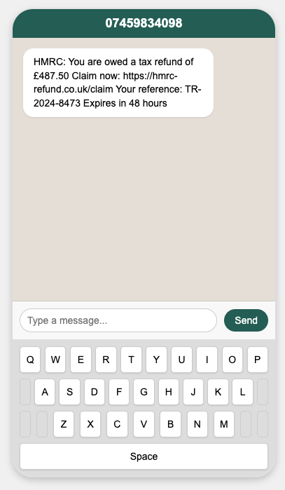
Message 1
SCAM ❌
Notes:
HMRC never sends tax refund texts
URL is NOT gov.uk
48-hour pressure
Unsolicited message
HMRC communicates by post

Slide 57
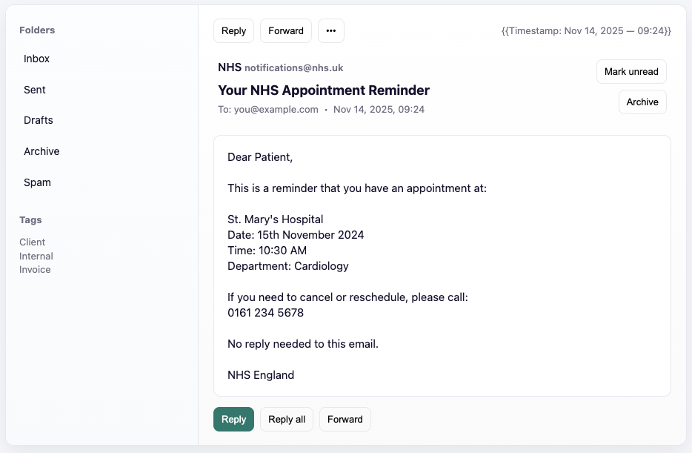
Message 2
LEGITIMATE ✓
Notes:
From genuine NHS email
No payment requested
No links to click
Provides phone number to call
Professional format
No urgency or threats Still check: Call hospital directly to confirm

Slide 58
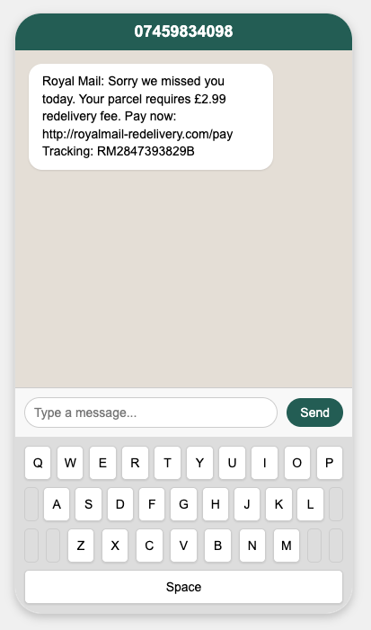
Message 3
SCAM ❌
Notes:
Royal Mail doesn't charge redelivery fees via text
They leave a card if you're out
URL is not royalmail.com
Asking for payment via link
If you're expecting a parcel, check Royal Mail website directly

Slide 59
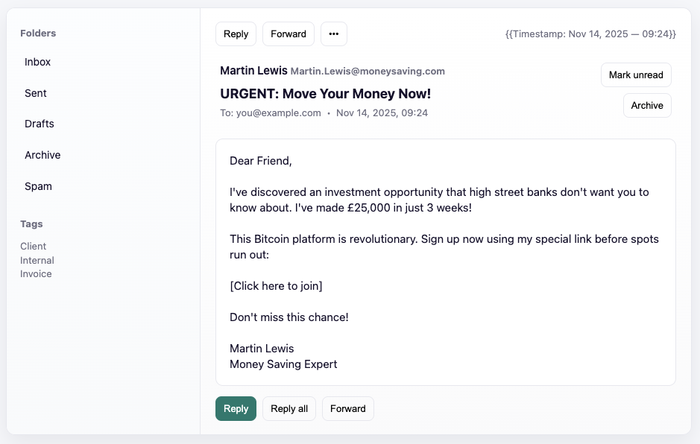
Message 4
SCAM ❌
Notes:
Martin Lewis NEVER sends these emails
He doesn't endorse investment products
Fake email address
Promise of quick money
Urgency ("spots running out")
Bitcoin/crypto investments in unsolicited emails
Martin Lewis regularly warns about these scams

Slide 60
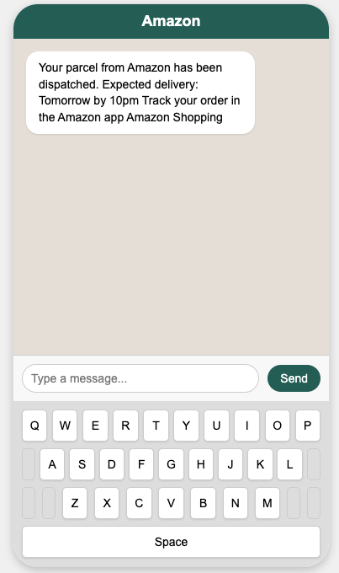
Message 5
LEGITIMATE ✓
Notes:
Why it's real:
Generic notification (not asking for action)
No links to click
No payment requested
Directs to official app
BUT: Only trust if you actually ordered something!

Slide 61
Message 6
SCAM ❌
"This is a message from HMRC Tax Office. We have identified a serious tax fraud case under your name. If we don't hear from you immediately, a warrant will be issued for your arrest. Press 1 to speak to an officer or call back on 020-7946-0123."
Notes:
Warning signs:
HMRC NEVER threatens arrest by phone
They don't use voicemail for serious matters
"Press 1" is a scam tactic
Creates panic and urgency
HMRC communicates by letter first
If you owe tax, you'll know about it already

Slide 62
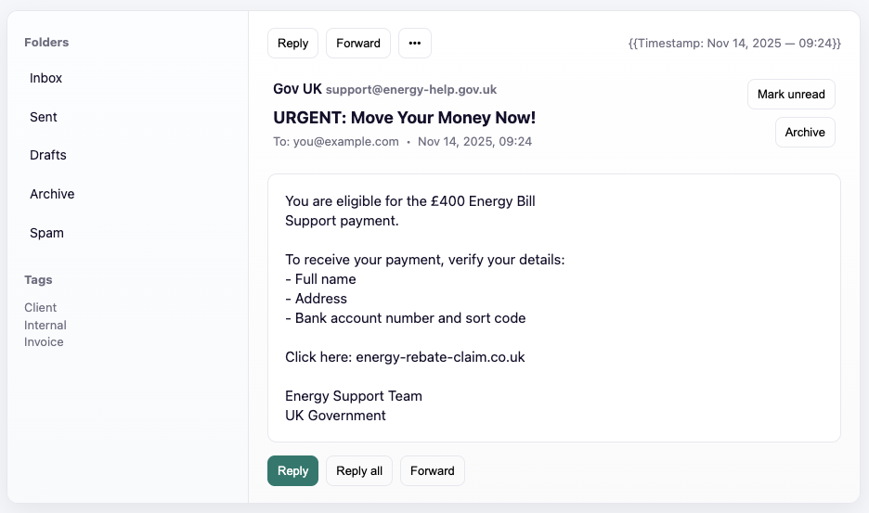
Message 7
SCAM ❌
Notes:
Warning signs:
URL is NOT gov.uk
Government doesn't ask for bank details by email
Real energy support was automatic (through supplier)
Asking for account numbers
Generic "UK Government" signature
Real support schemes don't work this way

Slide 63
Your Action Plan
Building better habits

Slide 64
What have we learned so far?
Skill 1: Stop, Question, Check, Decide
What is misinformation, disinformation, fake news
The difference between bias and accuracy
How to spot fake news
How to conduct fact checking and cross referencing
How to spot scams
Different type of scams
What to do if you have been scammed
Skill 2: Lateral reading
Skill 3: Reverse Image Searching
Skill 4: Check the Date
Skill 5: Cross-reference multiple sources
Skill 7: Recognising scam texts and emails
Skill 6: Look for Original Sources

Slide 65
Before you share – STOP – The 3-step check
STOP
Don’t share immediately!
Especially if it makes you angry, scared or excited.
Emotional content spreads fastest.
CHECK
Is the source trustworthy?
Can you verify it?
What do our fact checking websites say?
THINK
Could this harm someone?
What if it was false?
Would I want someone to check before sharing this?

Slide 66
Responding to false information
Challenging misinformation can be difficult
Are you close to them?
Are you sure you are right?
Is it worth it?
Would it damage the relationship?
Could the misinformation cause harm?
How misinformed are they?
How emotional are you?
Are you equipped to have the conversation?

Slide 67
Correcting false information
Do’s | Don’ts
✓ Be kind and respectful ✓ Ask questions ("Where did you see this?") ✓ Share fact-checking links ✓ Explain why it matters ✓ Use private messages for family ✓ Educate them rather than challenging them ✓ Accept that sometimes minds can’t be changed | ✗ Use others you know for support (spreads it further) ✗ Be condescending ("How could you believe that?") ✗ Share the false claim to debunk it (spreads it further) ✗ Get into public arguments ✗ Expect to change minds immediately

Slide 68
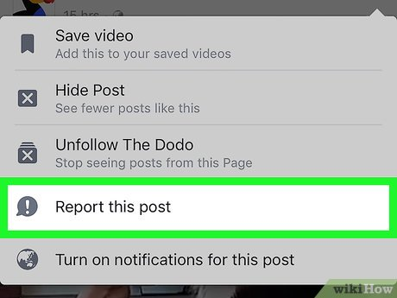
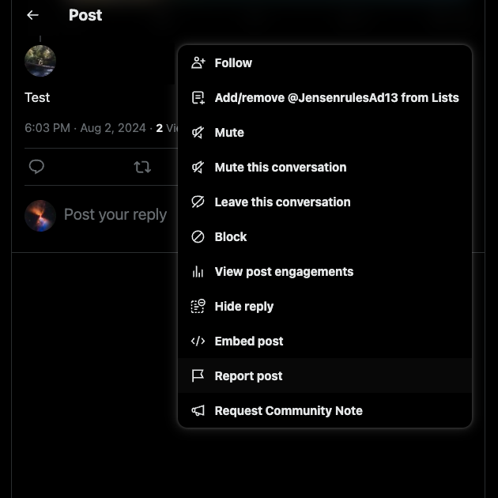
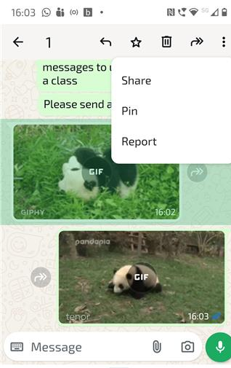
Reporting false content
Facebook
X (Twitter)
WhatsApp

Slide 69
Building Better Habits
Your Daily Information Diet:
✓ Follow trusted UK sources directly
✓ Read full articles, not just headlines
✓ Diversify your sources (different perspectives)
✓ Be sceptical of shocking claims
✓ Check before you share
✓ Take breaks from social media
✓ Talk to family about what you've learned

Slide 70
Trusted Sources to Follow
Build Your Feed
News Apps to Download:
BBC News
Sky News
ITV News
Channel 4 News
Fact-Checking:
Full Fact
BBC Reality Check
Scam Alerts:
Which? (sign up for Scam Alert emails)
Action Fraud updates

Slide 71
Your Take-Home Toolkit
Remember These 5 Things
Check the source before believing or sharing
Use Full Fact when in doubt
Banks never ask you to move money to "safe accounts"
STOP before you share emotional content
Report scams to Action Fraud immediately

Slide 72


Skill 1: Stop, Question, Check, Decide
Notes:
Icons ☺

