Slide 1
Using Technology Safely

Slide 2
Importance of physical security
Hundreds of thousands of phones are lost or stolen every year - it’s easily done!
Your phone gives you access to almost everything online (including email!) and many of our accounts are left logged-in on our phones
Your phone is likely to be your second factor! Someone with your phone could use it to get your 2-factor-authentication (2FA) codes.

Slide 3
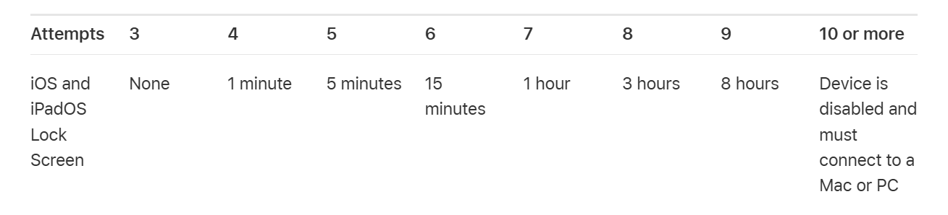
Lock types: PINs
PIN is the most common/simple method
PINs don’t have to be as strong as website passwords as they are kept on the device
Most smartphones will add a ‘cooldown’ period to stop repeated attempts
BUT they can be seen or guessed if you aren’t careful
Notes:
Main takeaway point: ignore both, but beware of emails that require action.

Slide 4
Good habits for PINs
Avoid simple or obvious patterns
  Repeated digits
  Sequential numbers
Don’t use personal information
Use 6 digits instead of 4
  Far stronger (assuming it’s not predictable)
  100x as many possibilities
  Harder to spot by shoulder surfing

Slide 5
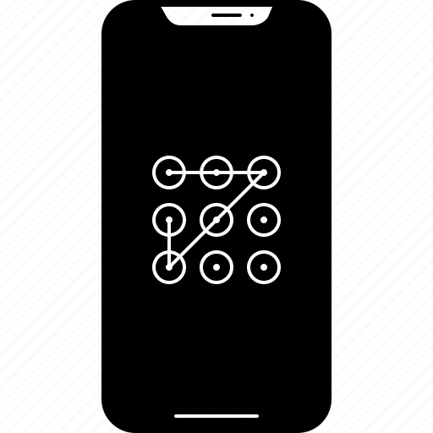
Pattern locks
A 3x3 grid of dots where you draw a line between the dots, forming a pattern
You might find this easier to remember
Research tells us 2 ways to make it harder for shoulder-surfers to memorise our pattern:
A longer, more complex pattern
Disable the ‘guide lines’ if your phone settings allow

Slide 6
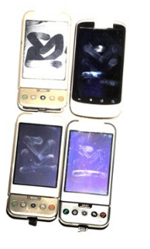
…and clean your screen!
PINs and (especially) patterns can be guessed (or at least narrowed down) based on smudges on the screen.

Slide 7
Biometrics
Finger scanner, face scanner… voice recognition?
Usually more convenient
No worries about ‘shoulder surfing’
Template stored on mobile device – not sent to ‘the cloud’
  You might need to rescan your fingerprints occasionally as they change over time
Can sometimes be inconsistent – you still need another unlock method, such as a PIN or pattern

Slide 8
Reality check – are they secure?
Good news – they’re all quite strong!
It’s very unlikely someone can get into a locked phone unless they already know the password – so be aware of your surroundings for shoulder-surfers!
The software and tools that could help someone ‘crack’ a phone are very exclusive – they are expensive and often only sold to law enforcement

Slide 9
Viruses and Malware
Malware is the overarching term for malicious software
A virus is a type of malware, but there are others
You can get them from
  Downloaded software
  Emails
  Websites
  USB drives
Be very careful installing software:
  Especially if someone else has asked you to (scammers often will)
On mobile, always install from the app store for your device
  Apple: App Store
  Google: Google Play

Slide 10
Malware: Virus/Worms
What do they do?
  Just like a real virus:
  Multiply and spread across files! Worms do this all on their own
  Delete files
  Can install ‘backdoors’ (send information to attacker)
  Can just slow down your computer
Alarm bells:
  Computer running slowly
  Files are missing
  Your hard drive space is disappearing

Slide 11

Malware: Trojan (horse)
What do they do?
  Does everything a virus/worm does
    Delete files
    Download other malware
    Remote access
    Steal data (spyware)
  Needs to be ‘activated’ by the user
  Usually comes bundled with another (real) program
  Remember your vigilance tips!
Alarm bells:
  Computer running slowly
  Files are missing
  Your hard drive space is disappearing
You can buy trojan ‘kits’ on the internet which allow you to make simple variations of existing trojans.
Usually spread through email or messaging applications (users will download them)
This means that it is very difficult for antivirus software to keep up to date!

Slide 12
Malware: Ransomware
What do they do?
  It is a form of trojan
  It will encrypt your files so you can no longer use them!
Alarm bells:
  You get a message saying your files have been encrypted
Do not:
  Pay the ransom. Do you trust them to decrypt your files?
  Delete the ransom note! You might be able to decrypt your files if you know how they were encrypted
    https://id-ransomware.malwarehunterteam.com/
Do:
  Disconnect the infected computer from the internet – ransomware can spread!

Slide 13
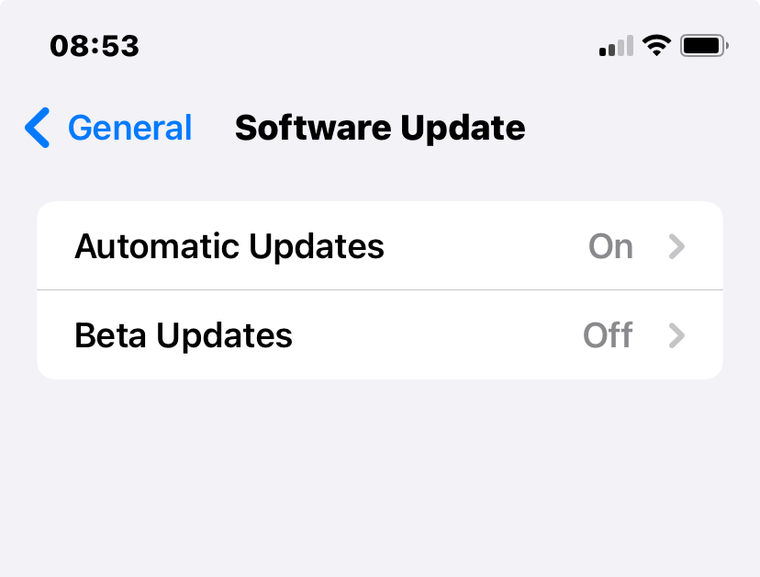
Software updates
Your devices are run by software
  Made by people
  People make mistakes
When software vulnerabilities are discovered, updates will be released to “patch” those issues
Always keep your devices up to date
  Consider enabling automatic updates in your settings
Be wary of using mobile devices that can no longer receive security updates

Slide 14
Antivirus/antimalware software on computers
Apple and Windows computers have adequate antivirus software included for free.
Additional antivirus software exists, and you might get a free trial with your computer
  You might not need anything additional to the built in software
  Beware being upsold additional things you might not use
  3rd party antivirus software might interfere with your built-in protection
  Research these products before installing them
Make sure your antivirus software is kept updated automatically
Set your software to scan new files
  Run a full system scan if you’re worried about your computer

Slide 15
Antivirus/antimalware software on mobile devices
No additional software should be needed
Remember, only install from the official app stores
Keep your device and apps updated automatically

Slide 16
Browsing safely

Slide 17
Man in the middle attacks
YOU
WEBSITE
Private information

Slide 18
Man in the middle attacks
YOU
Private information
ATTACKER
Whatever the attacker wants
WEBSITE
Whatever the attacker wants
Private information

Slide 19
Man in the middle attack types
On the same WiFi network as you and pretends to be your router
Setting up a fake WiFi network
  e.g. Linskill_Free_FAST
Compromised WiFi router
  e.g. default weak password
Unsafe apps or Malware on your device

Slide 20
Avoiding Man In The Middle: HTTPS
Websites that start with https:// not http://
  This is most websites, now
Connections to HTTPS websites are encrypted
  It is gibberish to anyone who intercepts
A website having HTTPS doesn’t mean it’s safe, only that other people can’t see what is sent.
  Scam websites will probably have https too
HTTPS connections are backed up by certificates
  You can check that they are who they say they are on your web browser

Slide 21
Avoiding Man In The Middle: Public WiFi
Public WiFi network introduce risk
If possible, use mobile data instead
  Also known as “hotspot” on your device
If you need to use public WiFi, limit activities
  You don’t know who is controlling the WiFi
If you use public WiFi, double check that the network is correct
  E.g. check with reception what their WiFi is called

Slide 22
Avoiding Man In The Middle: VPNs
Virtual Private Network (VPN)
Creates a secure connection with another computer somewhere else (usually another country)
Everything you do goes through that computer and can’t be intercepted
However
  The VPN service will see everything you do
  VPNs usually cost money
  Free VPNs could be malicious
  VPNs can slow down your computer
  Probably overkill in many cases

Slide 23
URLs
URLs are web addresses
  For example, https://www.bbc.co.uk/news
They are unique
They can be confusing to look at
Scammers can create URLs aiming to trick users
  Websites that are very close to the real thing but one letter off
  Websites that switch parts of the URL around
  Email addresses that look like the real deal

Slide 24
https://www.bbc.co.uk/news
https tells us the connection is encrypted
www = world wide web
  This part doesn’t really matter any more
bbc.co.uk is the domain, the actual website you’re visiting
/news is a specific page on that site
Websites always have a top-level domain
  .com, .co.uk, .org, .ac.uk etc
The part just before the top-level domain is the name of the website.
  Read from the right

Slide 25
Always look carefully!
bbc.co.uk.breaking-news.com
  Goes to breaking-news.com (read from the right)
bbc-news.co.uk
  Does go to bbc-news, but this is not the domain used by the BBC
  Search engines can (usually) help you find the right domain
  Password managers can be useful here, as they remember the URL for your accounts
bbc.co.uk.info
  Goes to uk.info (.info is one of the rarer top-level domains)
bbc.co.uk/news
  Goes to the news page at the BBC website

Slide 26
The same applies to emails
Sender:
northumbria@james.com
  This is from account “Northumbria” at james.com
james@northumbria-direct.com
  Northumbria-direct isn’t the right domain
jamesnorthumbria@gmail.com
  Anyone can make a gmail account (or any other widely available email service)
More on phishing scams tomorrow …

Slide 27
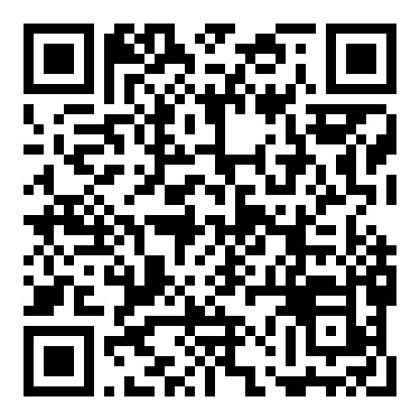

Slide 28
QR codes and shortened links
QR codes are two dimensional barcodes
They express data visually, usually URLs
They can be genuinely very useful
BUT, use them with caution
  Check the link
  Watch out for fake QR codes stuck over genuine ones (e.g. parking meters)
Similarly, avoid shortened links where possible (e.g. tinyurl.com/jf25cac2)
  Could go anywhere

Slide 29
Safe shopping
Check the URL
Look for HTTPS
Stick to retailers you know (where possible)
  Check reviews for unfamiliar sites (e.g. trustpilot)
  Avoid following ads on social media
Be wary of amazing deals
Credit card offers good fraud protection
PayPal / Apple Pay / Google Wallet can prevent you needing to enter card details

Slide 30
Cookies
Cookes are small pieces of text that get saved to your device
Websites use them to remember things about you
  Logging in; remembering shopping cart etc
  These things are usually classes as “essential”
They can also be used to record other things
  Websites you’ve visited
  What you’ve looked at
Third party cookies let advertisers track you across the internet
Not a security risk (usually), but damages privacy
In the EU (and UK), websites have to tell you what cookies they use and let you object to non-essential cookies
  Look for “reject all”, “manage preferences” or “essential only”
Some browsers (or browser extensions) let you control what cookies you allow

Slide 31
Key Takeaways
Keep your devices safe and secure with a strong PIN
Keep your devices up to date
Make sure your device is protected
  Mobile devices – always use official app stores
Avoid public WiFi where you can
Know how to read URLs and email addresses
  Be cautious when scanning QR codes
Shop sensibly and with known retailers
  Otherwise research carefully and take precautions
Don’t worry about cookies, but stick to essential where you can

